Slide 1
Communication, Apology and Resolution (CARe): How adverse events are addressed with CARe at [INSERT YOUR FACILITY NAME HERE]
Notes:
Cover slide

Slide 2
Background

Slide 3
[Facility name] CARe Information
Insert facility background information
When hospital/facility joined CARe
Local contacts and resource links (intranet pages)
Meeting times and goals re: CARe

Slide 4
About CARe

Slide 5
Communication, Apology and Resolution: The basics
Communicate and apologize
Proactively communicate with patients/families about unexpected adverse events
Offer empathy and, where appropriate, an apology of responsibility
Investigate
Investigate the events to find root causes, determine preventability, and develop corrective actions to improve patient safety
Move toward healing
Have resolution conversations to discuss review findings with the patients/families
Resolve
Resolve cases with compensation outside of the court system (patients who may receive compensation are encouraged to have attorneys)
Ensure patient safety improvements are made
Use CARe Support as needed
Connect them with team members who can help them throughout CARe process
Proactively move the case to the insurer for potential compensation-based resolution if criteria are met (i.e. a lapse in standard of care caused significant harm)

Slide 6



Why use CARe?
 | Better for patients Treated with compassion, honesty, and equity Can get the answers and support they need and want Fairer and more timely process than court system
 | Better for providers Preserves provider/patient relationship when possible Can express natural empathy and get the emotional support they need Systemic root causes are more likely to be unearthed and incorporated into resolution
 | Better for the health care system Less defensive medicine Accountability for improvements to system increased Builds trust in the system which improves reporting and morale, and helps reputation

Slide 7
What does the data show?*
Claims and costs do not increase even when systematically using CARe, and in many cases, costs decrease
Providers are supportive of the use of the program
Patients are supportive of the use of the program (Betsy Lehman Center data)
Patients who do not receive components of the program can suffer long-term negative impacts (Betsy Lehman Center data)
Systematic, rigorous application of the program is needed to receive the full benefits of the program, including improved safety culture
*See article links in appendix.

Slide 8



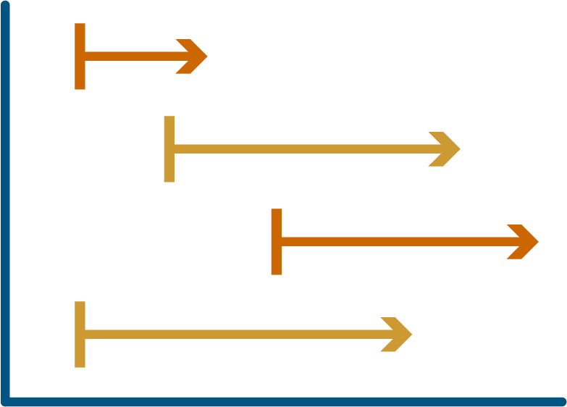
CARe: A rigorous program
The benefits realized can only happen when the program is reliable
Algorithms must be applied every case, every time
Cases are tracked to help ensure good communication and adherence to process
Data is reported to the Betsy Lehman Center for collective learning

Slide 9
How it works

Slide 10
Which adverse events are CARe cases?
CARe cases are reported adverse events that meet one of the following criteria:
Any case where harm has the potential to be at least temporary but "significant" harm, with "significant" defined as harm whose management is anticipated to require an invasive medical procedure or three or more additional visits to a health care center
Any case in which a patient is alleging the harm level above
Any event that needs reporting to BORM or DPH
Any event reported by a provider where CARe program is requested
Any case initiated by a pre-litigation notice
CARe cases receive the CARe process. It does not mean there was an error or that they will receive compensation. There will be many more CARe cases than CARe insurer cases, which will be described in later slides.
Download: Sample tracked event criteria

Slide 11
Initial communication
COMMUNICATE EARLY
Communicating with the patient/family about the adverse event early is essential. This is sometimes known as a “disclosure” conversation.
Disclosure tips from Betsy Lehman Center: Clinician communication algorithm
PREPARE FOR THE CONVERSATION
Providers have support for disclosure conversations through just-in-time coaching [insert site-specific coaching information]
You will be responsible for assisting these providers in disclosure conversations. If you need more training on how to coach providers, contact your supervisor or Melinda.VanNiel@BetsyLehmanCenterMA.gov
Note: There will be cases that do not qualify as CARe cases that still require disclosure. Please refer to [Institution policy] for more information

Slide 12
CARe adverse event pathway
CARe event occurs and is reported to you
Standard of care NOT met and caused significant harm
CARe Insurer Pathway: In coordination with insurer; explain what happened, formally apologize, proactively offer compensation
Standard of care met or low-level harm
Explain what happened and answer patient questions; continue to express empathy; option of good will gesture
Respond immediately to the patient’s clinical needs, communicate proactively, express empathy, investigate, make changes to improve patient safety and inform patient of those changes
15%
85%

Slide 13
Core of the CARe process
Respond immediately to the patient’s clinical needs, communicate proactively, express empathy, investigate, make changes to improve patient safety and inform patient of those changes
Your organization uses a tracking sheet to track cases that meet CARe criteria, ensuring steps are completed for each case
This includes making sure full disclosure occurred, holding bills, assigning a patient relations team member to be the patient contact, investigating, having a resolution conversation with the patient and family, and referring to insurer/claims if criteria are met
The columns are designed to prompt the steps of the process
All CARe cases get resolution conversations
Resolution conversation training is available; the resolution conversation checklist used to prepare for these conversations is here.

Slide 14
Defining a “CARe insurer case”
CARe insurer cases are cases where the event review finds*
The standard of care was not met, AND the unmet standard of care caused significant harm
There is a question around these issues that can only be resolved through assistance from the insurer, including patient representation by an attorney (through claim letter or other means)
OR
CARe insurer cases require you to refer the case proactively to the insurer for review for possible compensation. Language for this conversation with a patient can be found here.
CARe insurer cases that meet the causation and harm criteria above cannot just be resolved by bill waiver/CARe Support/Service Recovery unless the patient has declined the offered insurance review.
*If, after review, the team is still unsure about standard of care, causation or significant harm, please consult with your insurer/claims department about how best to proceed. Being honest with the patient about this uncertainty is okay, but other options such as external experts could be pursued ahead of the discussion if warranted to help better determine if it is a CARe insurer case.

Slide 15
All CARe cases require:
CARe insurer cases additionally require:
Resolution conversation with patient/family re: event review findings and any improvements that will be made
Proactively offering to connect patient/family to claims/insurer for further review and potential financial compensation
Consideration of CARe Support (aka service recovery)
CARe cases
meet CARe criteria
CARe insurer cases
meet CARe criteria AND review found that there was an error that caused significant harm
(see previous slide for more details)
Download: Sample tracked event criteria

Slide 16
Resolution conversations
WHEN | The discussion happens after the event review or investigation has occurred. Resolution in a case where the standard of care was met is still required. This helps the patient understand that their concerns were taken seriously.
WHAT | The patient/family finds out the causes of the event, asks questions and has concerns addressed, and learns what is being done to prevent the event from happening again if applicable. Resolution itself should be comprehensive and not only address financial concerns. Often sites ask the patient/family what would be helpful; while compensation can be helpful, they may also desire assistance coordinating care, the ability to name a room or lecture series after a loved one, or participation in education around the event's issues.
WHO | Resolution conversations should include all parties involved.
HOW | Prepare in advance and use this checklist to guide you through the process. Training is available live, or in recorded version, through the Betsy Lehman Center.
Notes:
Pat

Slide 17
Support resources
For patients and providers that have been involved in adverse events

Slide 18


Support for patients and families
CARe Support
Historically called “service recovery”
In response to an adverse event, a health care organization — separate from insurers — makes payment(s) or gives assistance to patients or family members to support them in the short term
Covers items that would not have been needed if the adverse event had not occurred
Not compensation for injury: CARe Support should not be given in exchange for a release of the right to pursue a claim or lawsuit.
Download: Guiding principles for CARe Support. [Sites may want to add information about their own practices]
Peer Support
One-on-one emotional support from someone with lived adverse medical event experience
Free, confidential resource for MA residents from the Betsy Lehman Center
Learn more: Patient and Family Peer Support Network

Slide 19
Peer support for providers
[Sites add their own peer support information]
Virtual Peer Support Network: The Network connects health care professionals to one-one emotional support from a peer. The Betsy Lehman Center offers this free, confidential and virtual resource to providers in MA.
Learn more: Virtual Peer Support Network

Slide 20
Additional resources

Slide 21
More information on CARe
Visit the CARe website
Information, research, best practices and tools related to CARe: Communication, Apology and Resolution (CARe)
Contact us
Melinda Van Niel, MBA, CPHRM, Director of CARe Programs, Betsy Lehman Center
Melinda.VanNiel@BetsyLehmanCenterMA.gov

Slide 22
Betsy Lehman Center and CARe
DATA SHARING | As a CARe member, data is reported to the Betsy Lehman Center twice a year: Q1&2 in August, and Q3&4 in February. Data is collected from the tracking sheet and reported in aggregate. [If person in role for training will report this, add local link to your data reporting spreadsheet]
LEARNING COMMUNITY | The Center convenes a CARe Advisory Board and hosts discussion sessions – meetings for participant organizations to discuss challenges related to CARe – several times a year.
TOOLS AND RESOURCES | The CARe Resource Library has extensive tools and resources free of charge.

Slide 23
Appendix

Slide 24
Articles
Data addressing success factors: https://qualitysafety.bmj.com/content/early/2020/01/20/bmjqs-2019-010296.long
Data addressing costs, claim numbers, and time to resolution, published November 2018: https://www.healthaffairs.org/doi/full/10.1377/hlthaff.2018.0720?url_ver=Z39.88-2003&rfr_id=ori%3Arid%3Acrossr ef.org&rfr_dat=cr_pub%3Dpubmed
Data addressing claims numbers, provider satisfaction, and adherence published in Health Affairs in 2017: http://www.healthaffairs.org/doi/10.1377/hlthaff.2017.0320
Data regarding patients and medical error in Massachusetts: https://www.betsylehmancenterma.gov/research/costofme

